Slide 1
Apache Ambari Overview
Nitiraj Rathore
Pallav Kulshreshtha
April 2017
Notes:
Hello everyone. I am Nitiraj from Hortonworks. I am here with my colleague Pallav. We are here to give a presentation on “Apache Ambari”.
Before I start a brief introduction about me. I have done B.tech and M.tech from IIT Roorkee and have been working with Hortonworks for last 2 years now.
I am an Apache Ambari committer for more than a year now.
So, let me through some quick questions first…
How many of you have used hadoop?
Ok great.
How many of you have heard of Ambari before?
Not bad
How many of you have used Ambari before?
Ok great ..
My hope is that after this presentation, the next time you think of using hadoop you will think of doing it through Ambari.

Slide 2
Agenda
Background, Release History
Ambari Alerts and Metrics
Ambari Blueprints
Security Setup (Kerberos, RBAC)
Automated Cluster Upgrade
Extensibility: Stacks and Views
Demo

Slide 3
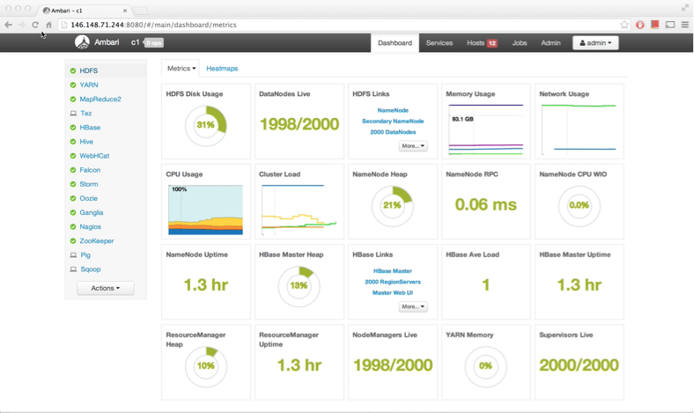
What is Apache Ambari?
A completely open source management platform for provisioning, managing, monitoring and securing Apache Hadoop clusters. Apache Ambari takes the guesswork out of operating Hadoop.
Notes:
Ambari is a great opensource software to do almost everything that you need to do with hadoop. Ok atleast this is where we are heading.
Using ambari you can install and remove hadoop services, you can monitor your hosts and monitor your services as well, easily secure your cluster and on top of that you can access hadoop data, jobs etc right from your browser window.

Slide 4
Ambari Recent Releases
Ambari 2.2.0
Dec 2015
Ambari 2.2.2
Apr 2016
Ambari 2.4.0 GA
Aug 2016
Ambari 2.5.0 GA
April 2017
Introduced Grafana
Introduced
Log Search TP
Introduced
Hive LLAP GA
Introduced Express Upgrade
Notes:
Apache Ambari is released under Apache License version 2
Which brings me to the question why love Open Source software in general and Ambari in particular.
Hortonworks has also started open community for complete hadoop support by community. You can community.hortonworks.com

Slide 5
Why Ambari?
Open source
Huge community support
Easy and Intuitive to Use
Extensible
Customizable
Programmable
Scalable
Notes:
Ok this slide should have been… Why you would love Ambari
First its opensource, its freely downlodable and everyone can use it.
Ambari is a very active apache project which enjoys huge community support inside and outside of Apache.
Hortonworks has also started a community support. You can go to community.hortonworks.com and ask and give answers not just on Ambari by complete Hadoop ecosystem.
Ambari design is very intuitive and very visual. It make the mundane task of installation and monitoring quite interesting. It provide wealth of information about cluster and service health in graphical and visual forms
Its extensible. You can add your own service definitions, alerts, metricies, views and what not..
Its customizable. You can customize UI to quite an extend and you can choose your own way of security settings.
Its developer friendly. It gives you complete access to through REST APIs.
And its scalable for different views. We will discuss this later.

Slide 6
Hadoop Installation

Slide 7
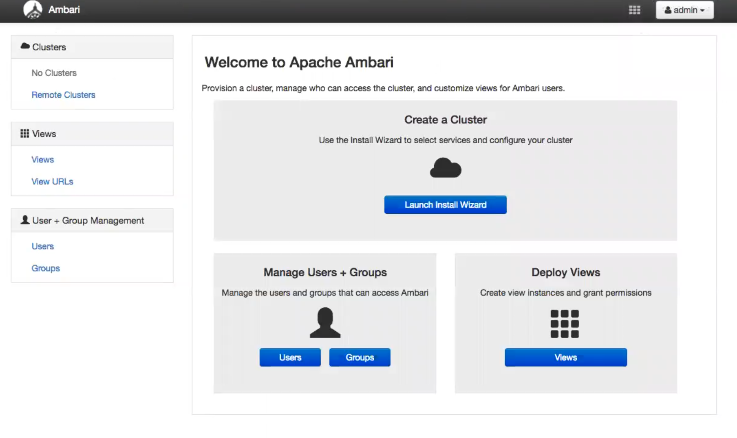
Notes:
This is the landing page when you first login into ambari.
Starting from the left --
Note that there is no cluster installed yet.
There is option of Remote Clusters where you can connect to the other Ambari Clusters. Very very usefull feature for scalability and accessebility. (Pallav will talk about this in brief later on)
There is wizard to manage Ambari Views (Pallav will discuss this later on.)
User and Group Management Links which will touch upon in a while.
The one which is more of interest right now is the Launch Install Wizard button.

Slide 8
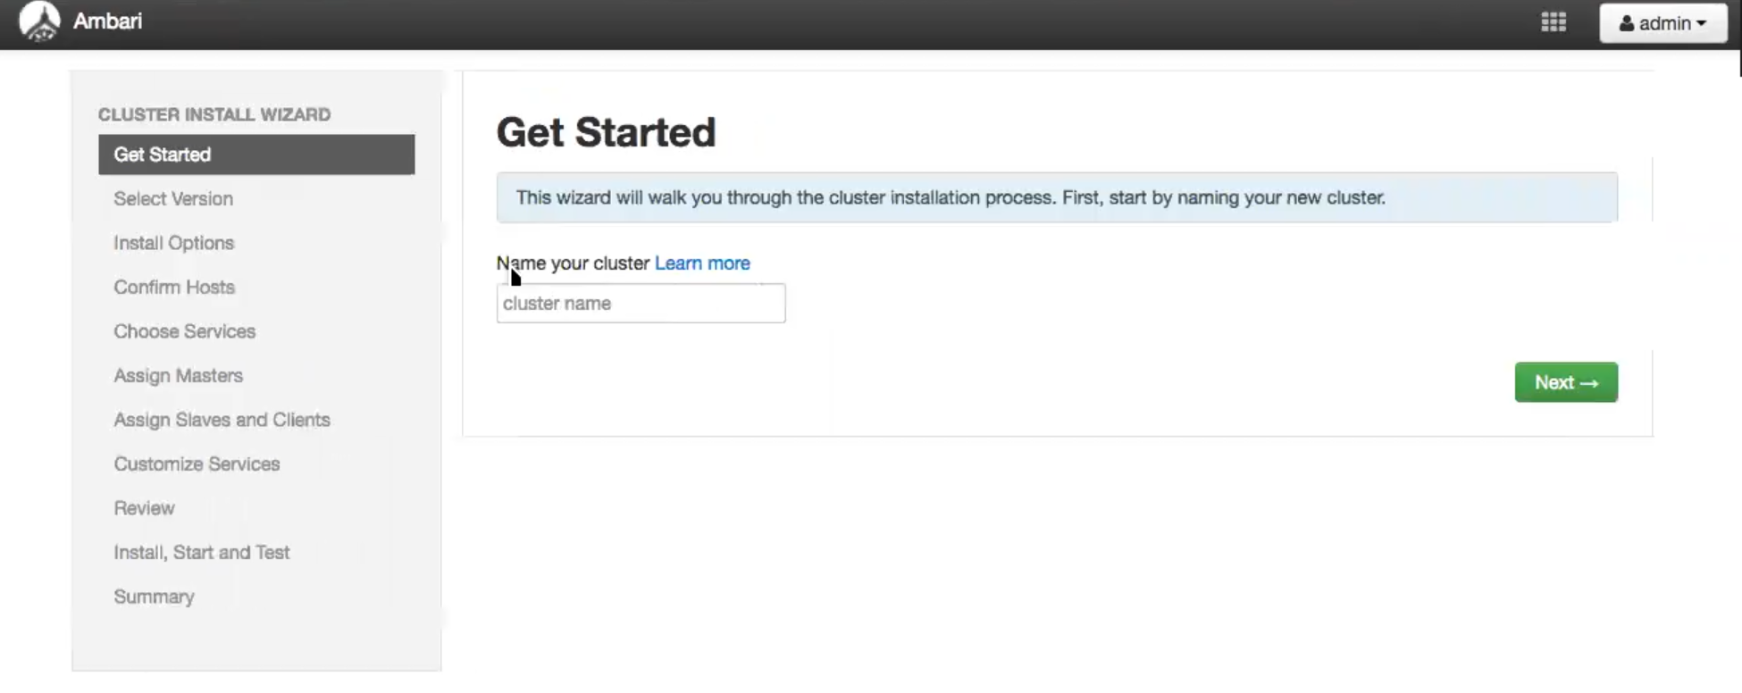
Name your cluster
Notes:
Give your cluster a meaningfull name. Remember this name will be used in all the REST APIs exposed by Ambari so if you are gonna do REST automation this name will be used a lot.

Slide 9
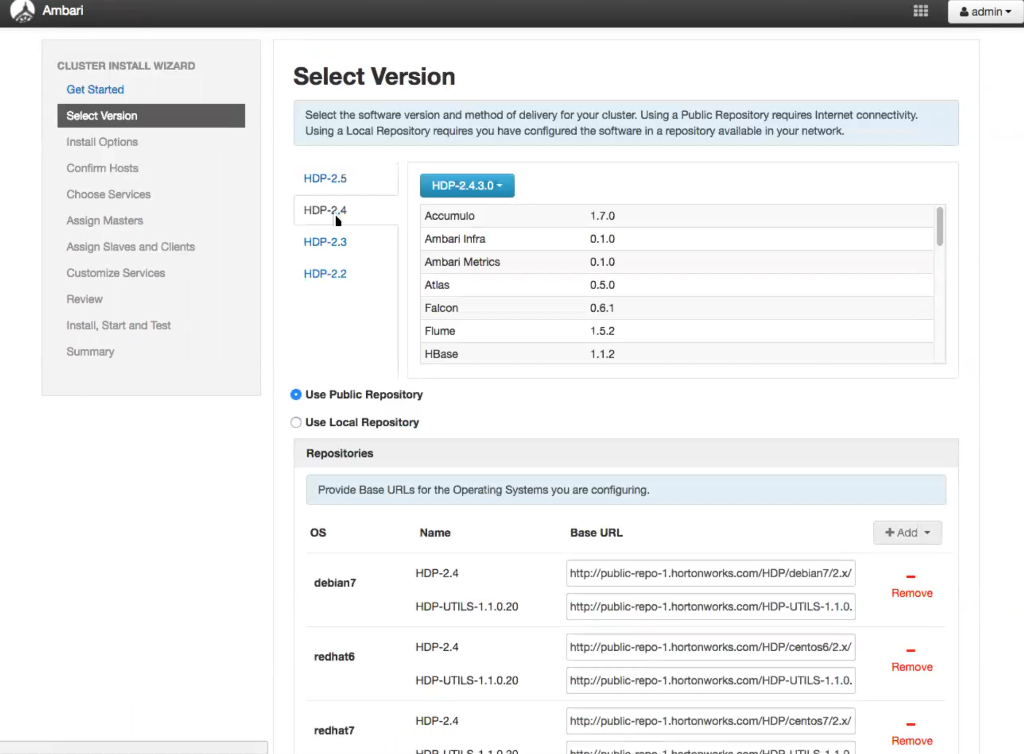
Select your HDP version
Notes:
Ambari supports different stacks. Stacks are basically definition and configuration of services. We will discuss stacks more later
The most popular stack for Ambari is HDP. Hortonworks Data Platform released publicly by Hortonworks
You can select which stack you want to install. The repositories will be selected automatically.
Alternatively you can provide Stack Version Definition file which will add new stack elements.

Slide 10
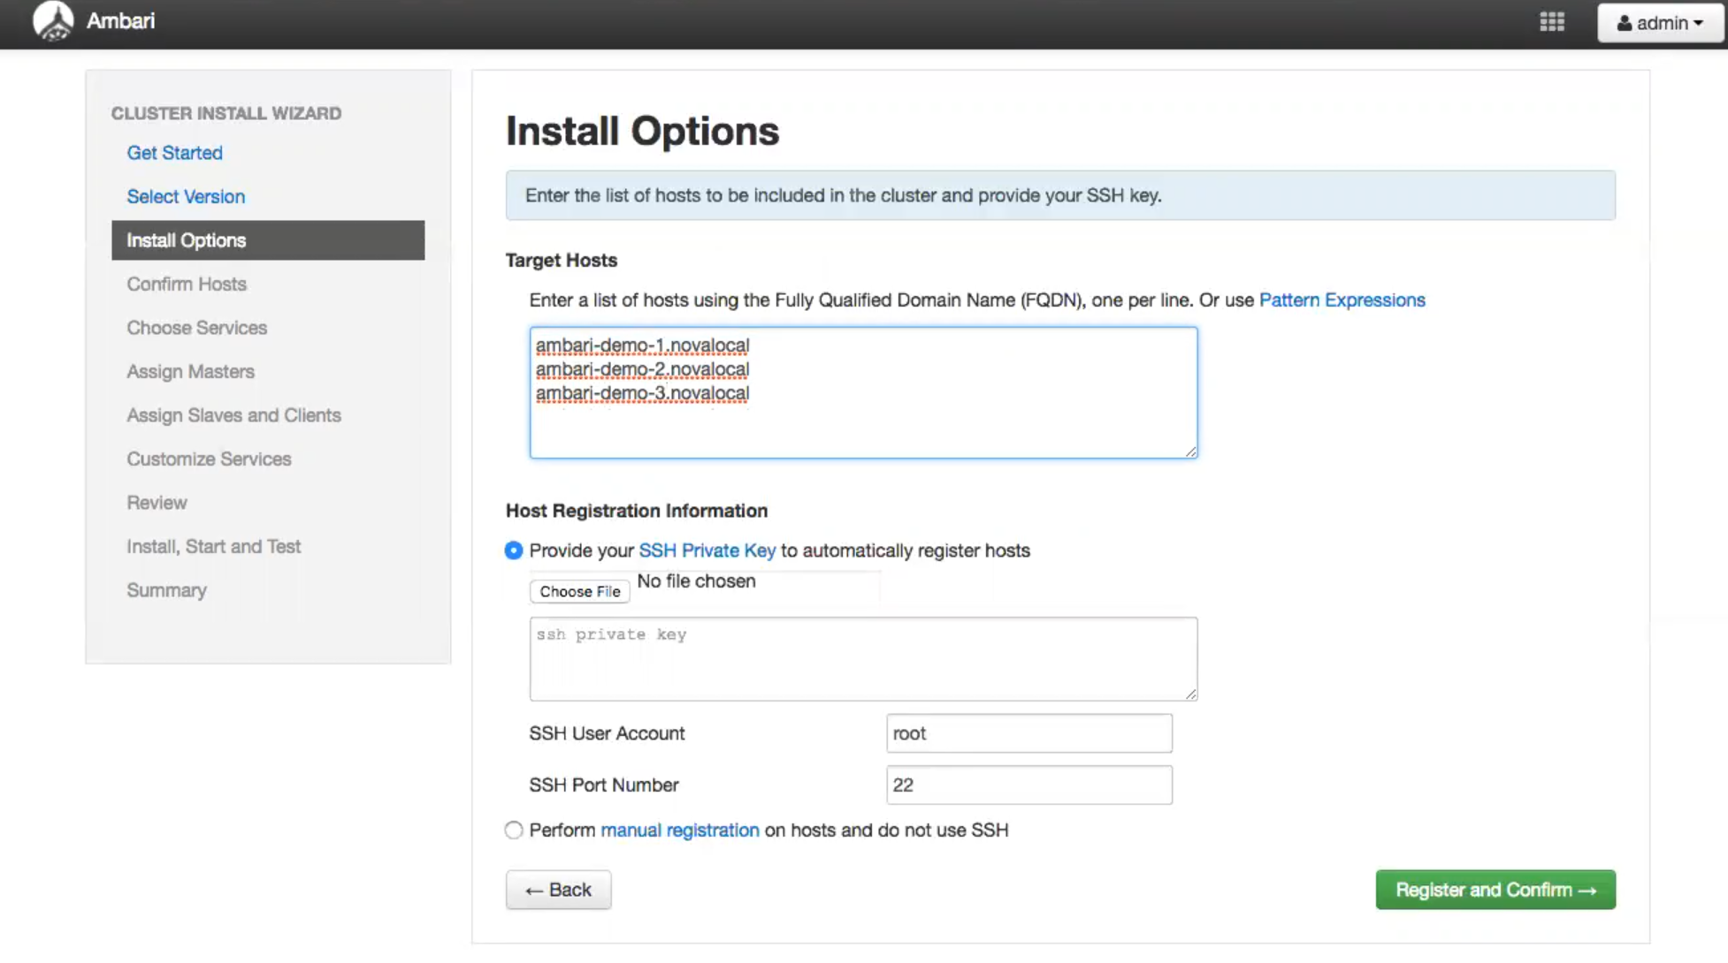
Enter host nodes
Notes:
You have enter FQDN’s of all the host which make up your cluster here. One host per line.
Next you can choose to give the ssh private key for you cluster so that ambari can automatically install Ambari Agents on all of the nodes.
Otherwise you can perform it manually on each host.
So basically Ambari has 2 parts to it. Ambari Agents which are installed on each host and Ambari Server which is installed on a single server.
Ambari Agents are the workhorse that do most of the jobs given by ambari server. Like installation, stop, start service etc etc..

Slide 11
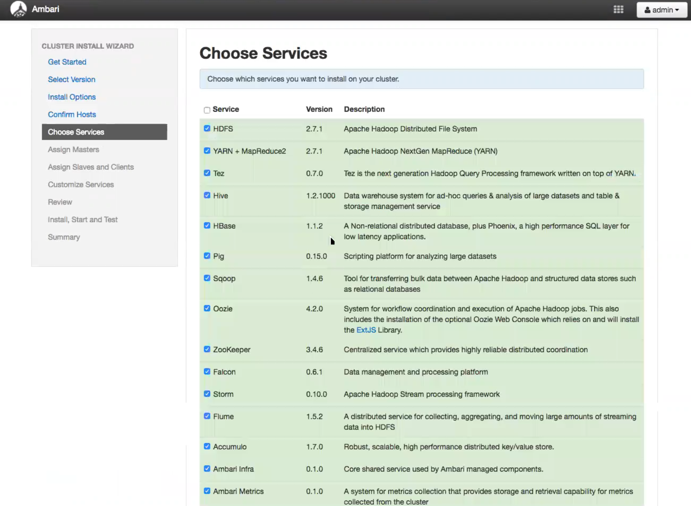

Slide 12
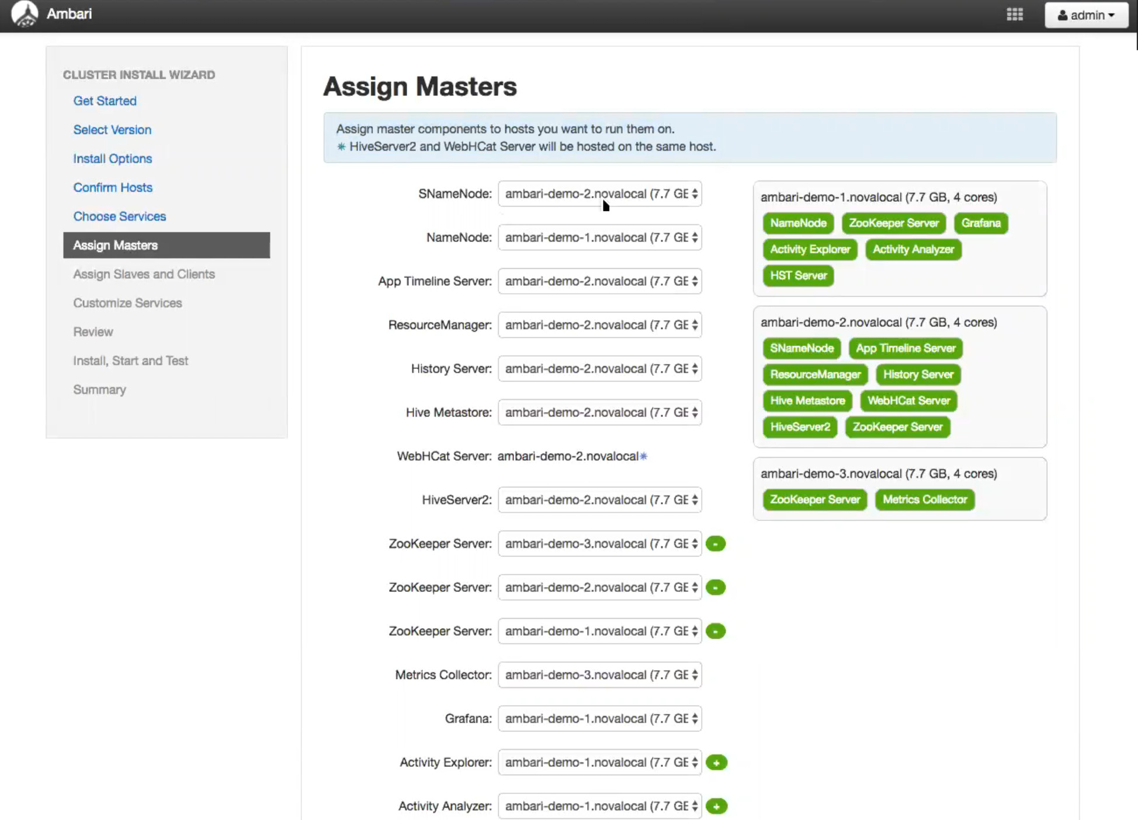

Slide 13
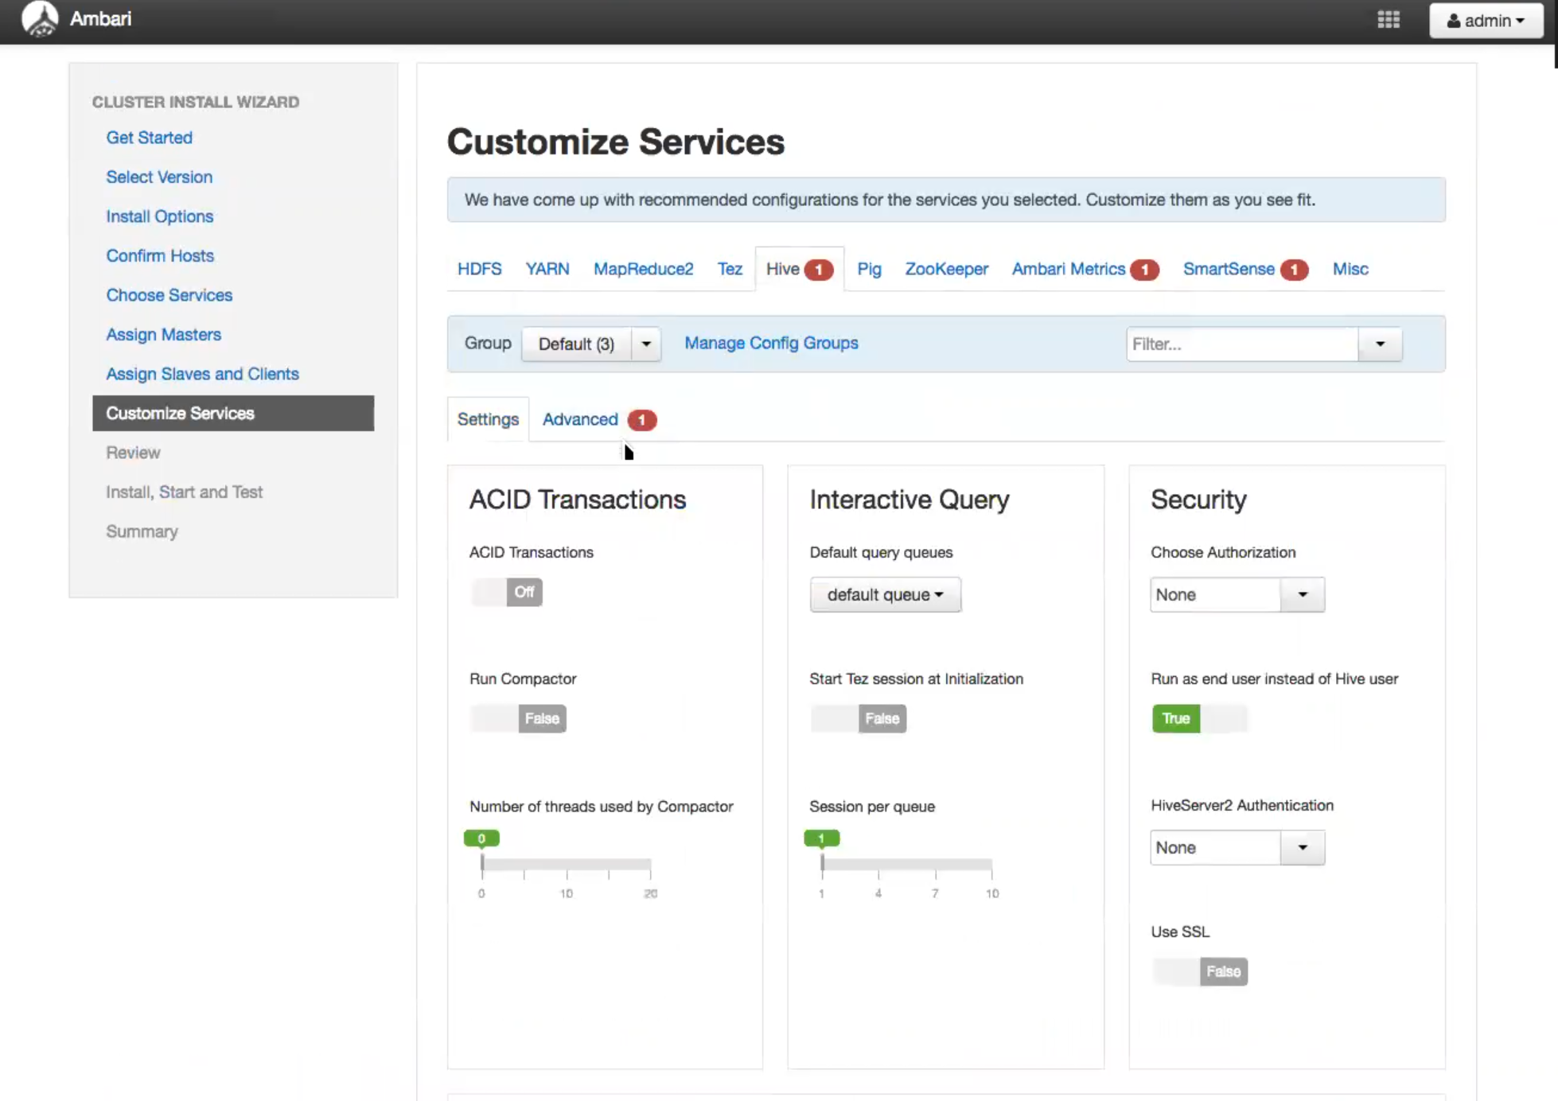

Slide 14
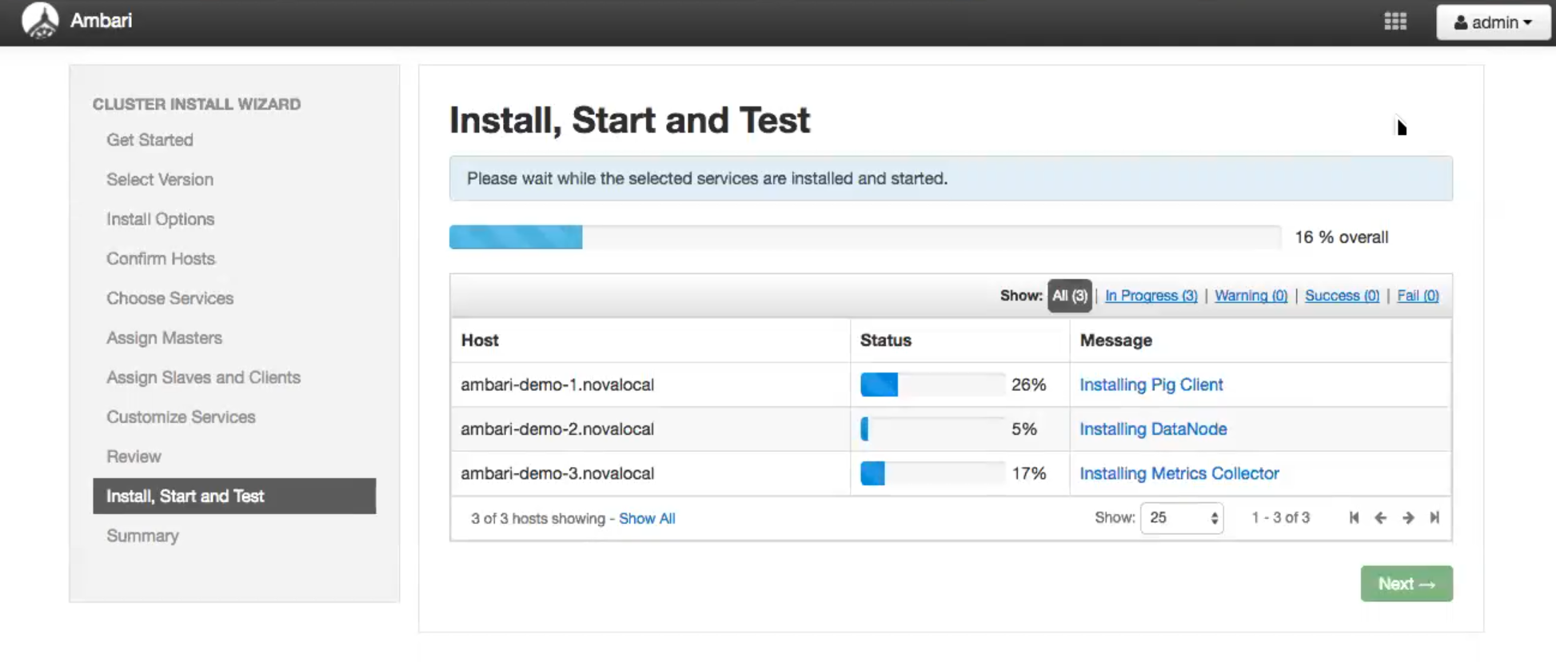

Slide 15
Notes:
And voila your cluster is ready. That’s it that’s all that is required to get your complete hadoop cluster up and running.

Slide 16
Ambari Metrics

Slide 17
Ambari Metrics
Built using Hadoop technologies : Phoenix, Hbase, ATS, HDFS/Local FS
Three components: Metrics Collector, Metrics Monitors, Grafana
Ambari
Server
Metrics Collector
4
3
1
2
Metrics Monitor
Sink(s)
Metrics Monitor
Sink(s)
Metrics Monitor
Sink(s)
Host1
Host1
Hosts
Notes:
Metric Monitors send system-level metrics to Collector
Sinks send Hadoop-level metrics to Collector
Metrics Collector service stores and aggregates metrics
Ambari exposes REST API for metrics retrieval

Slide 18
Ambari Metrics
List of Dashboards widgets
System Home, Servers
HDFS Home, NameNodes, DataNodes
YARN Home, Applications, Job History Server
HBase Home, Performance, Misc

Slide 19
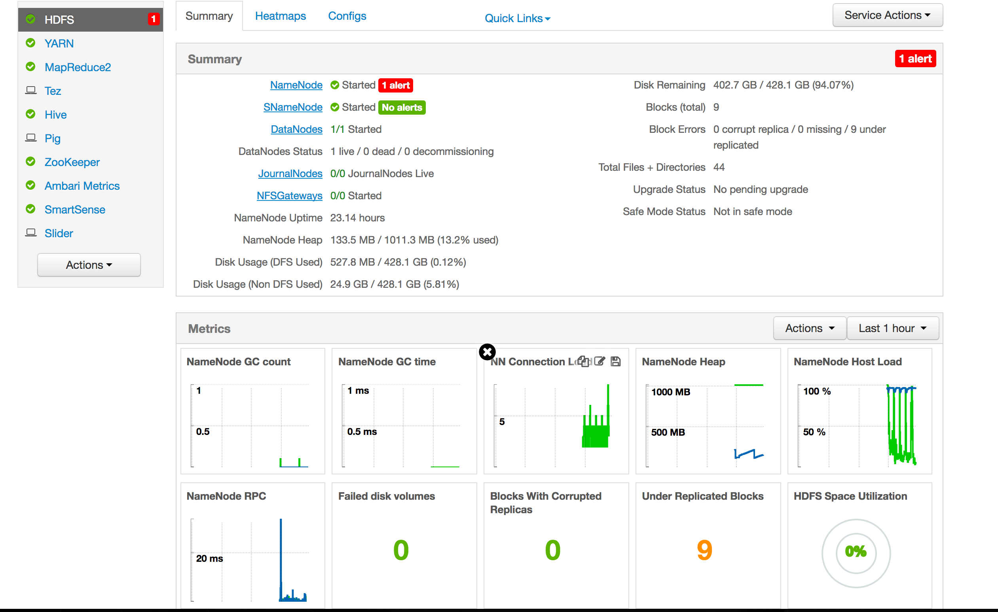
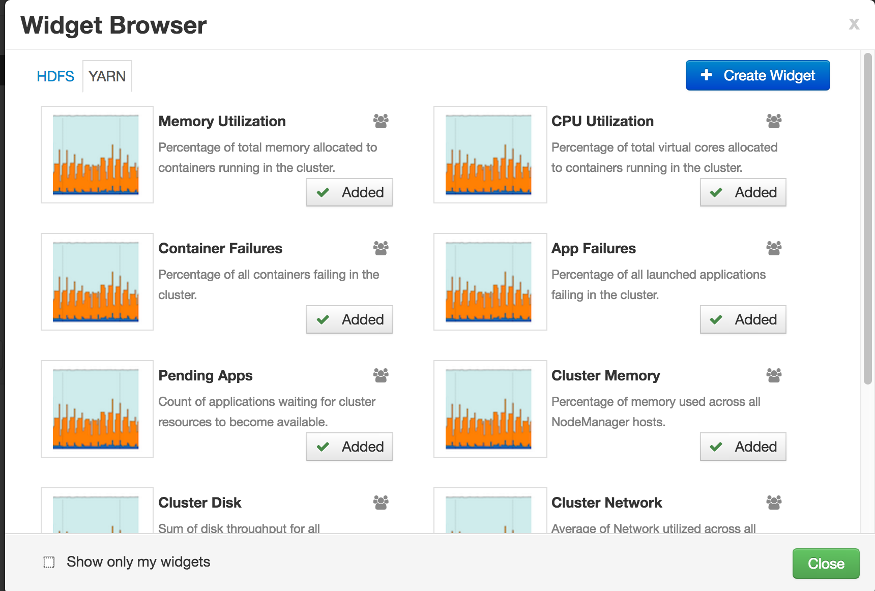
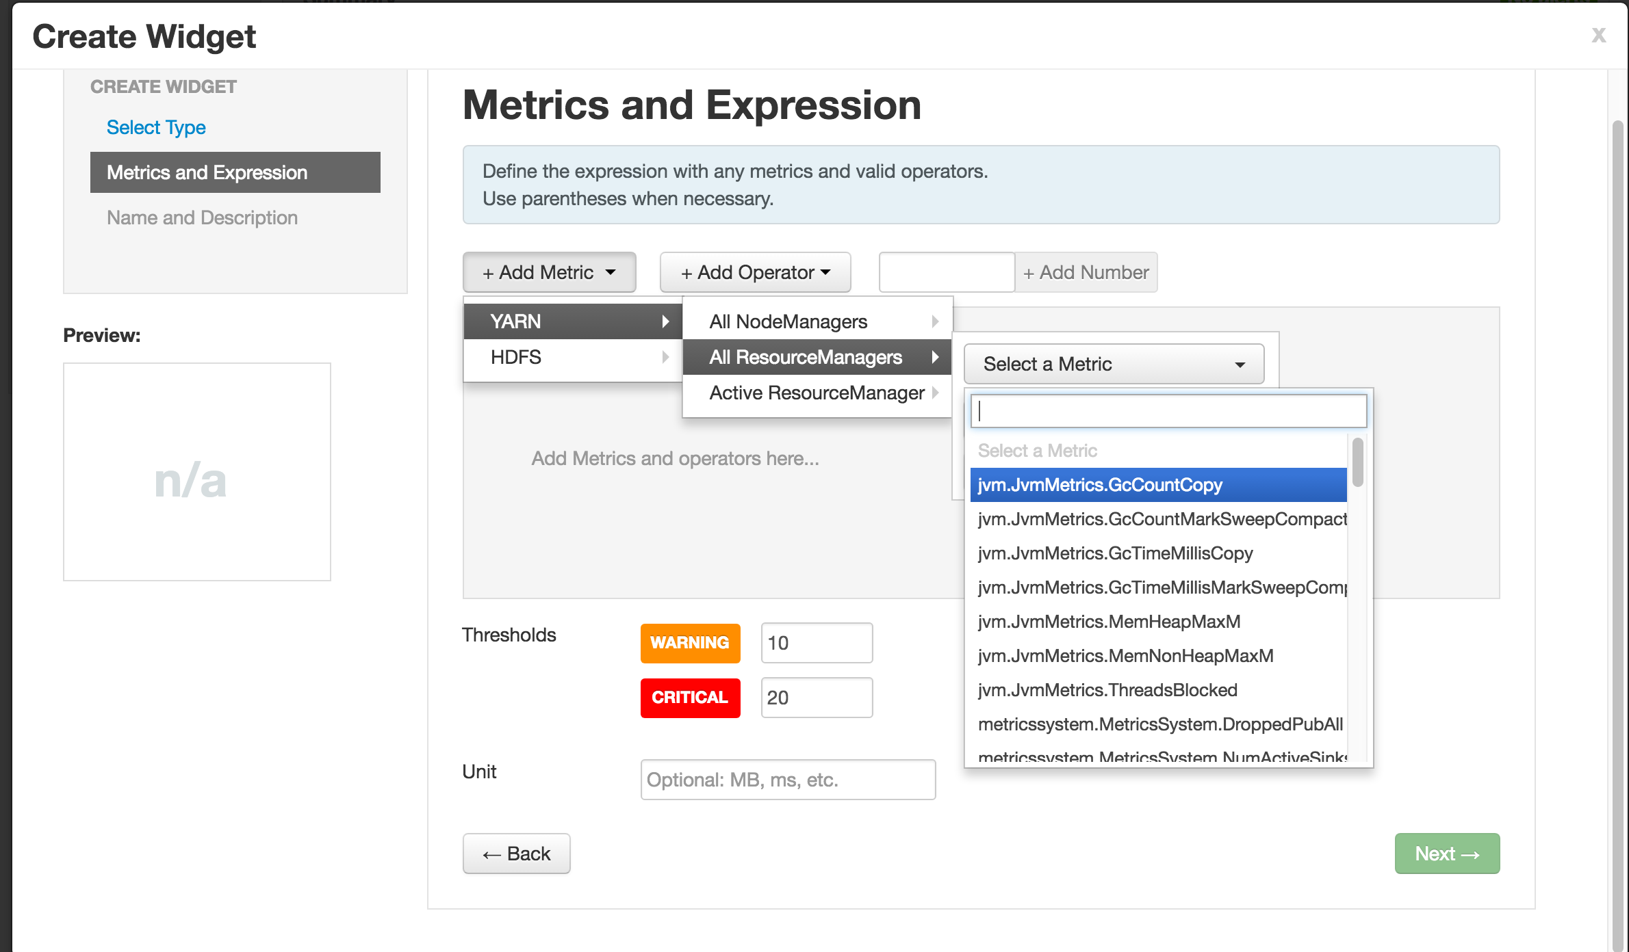

Slide 20
Ambari Alerts

Slide 21
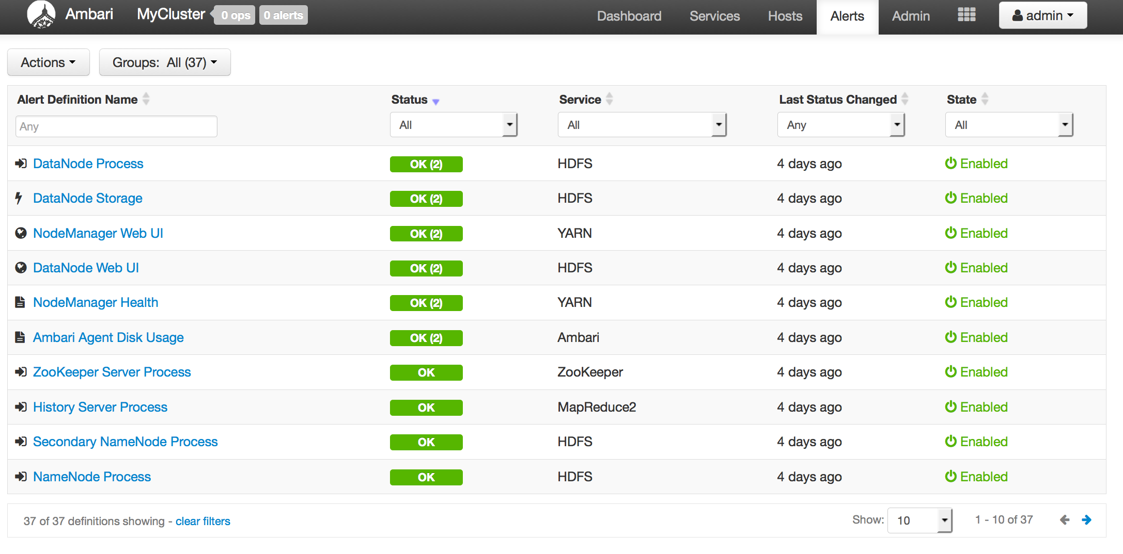
Full Visibility into Cluster Health
Centralized management of Health Alerts
Pre-defined alerts, configured by default on cluster install

Slide 22
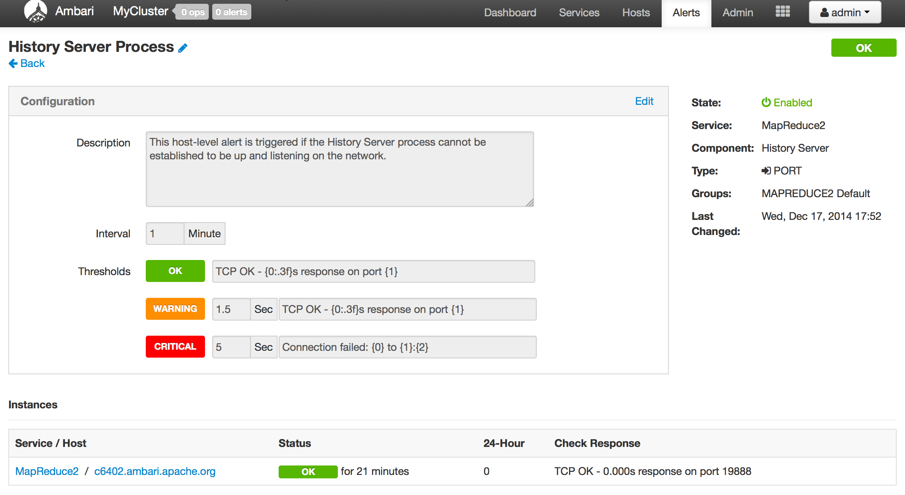
Customizing Alerts
Control thresholds, check intervals and response text
Notes:
What: Create and manage multiple notification targets
Control who gets notified when
Why: Filter by severity
Send only certain notifications to certain targets based on severity
How: Control dispatch method
Support for EMAIL + SNMP

Slide 23
Configuring the Check Count
Set globally for all alerts, or override for a specific alert
Global Setting
Alert Override

Slide 24
Ambari Alerting System
User creates or modifies cluster
Ambari reads alert definitions from Stack
Ambari sends alert definitions to Agents and Agent schedules instance checks
Agents reports alert instance status in the heartbeat
Ambari responds to alert instance status changes and dispatches notifications (if applicable)
email
snmp
5
Ambari
Server
1
3
Ambari
Agent(s)
4
2
Stack definition
alerts.json
Notes:
This shows in a nutshell how alerting mechanism works.

Slide 25
Ambari Blueprints
Notes:
This is one of most loved feature of ambari.
So you saw how easy it is to create hadoop cluster with ambari.
What is easier? .. To create the same or I should say similar cluster again !! .

Slide 26
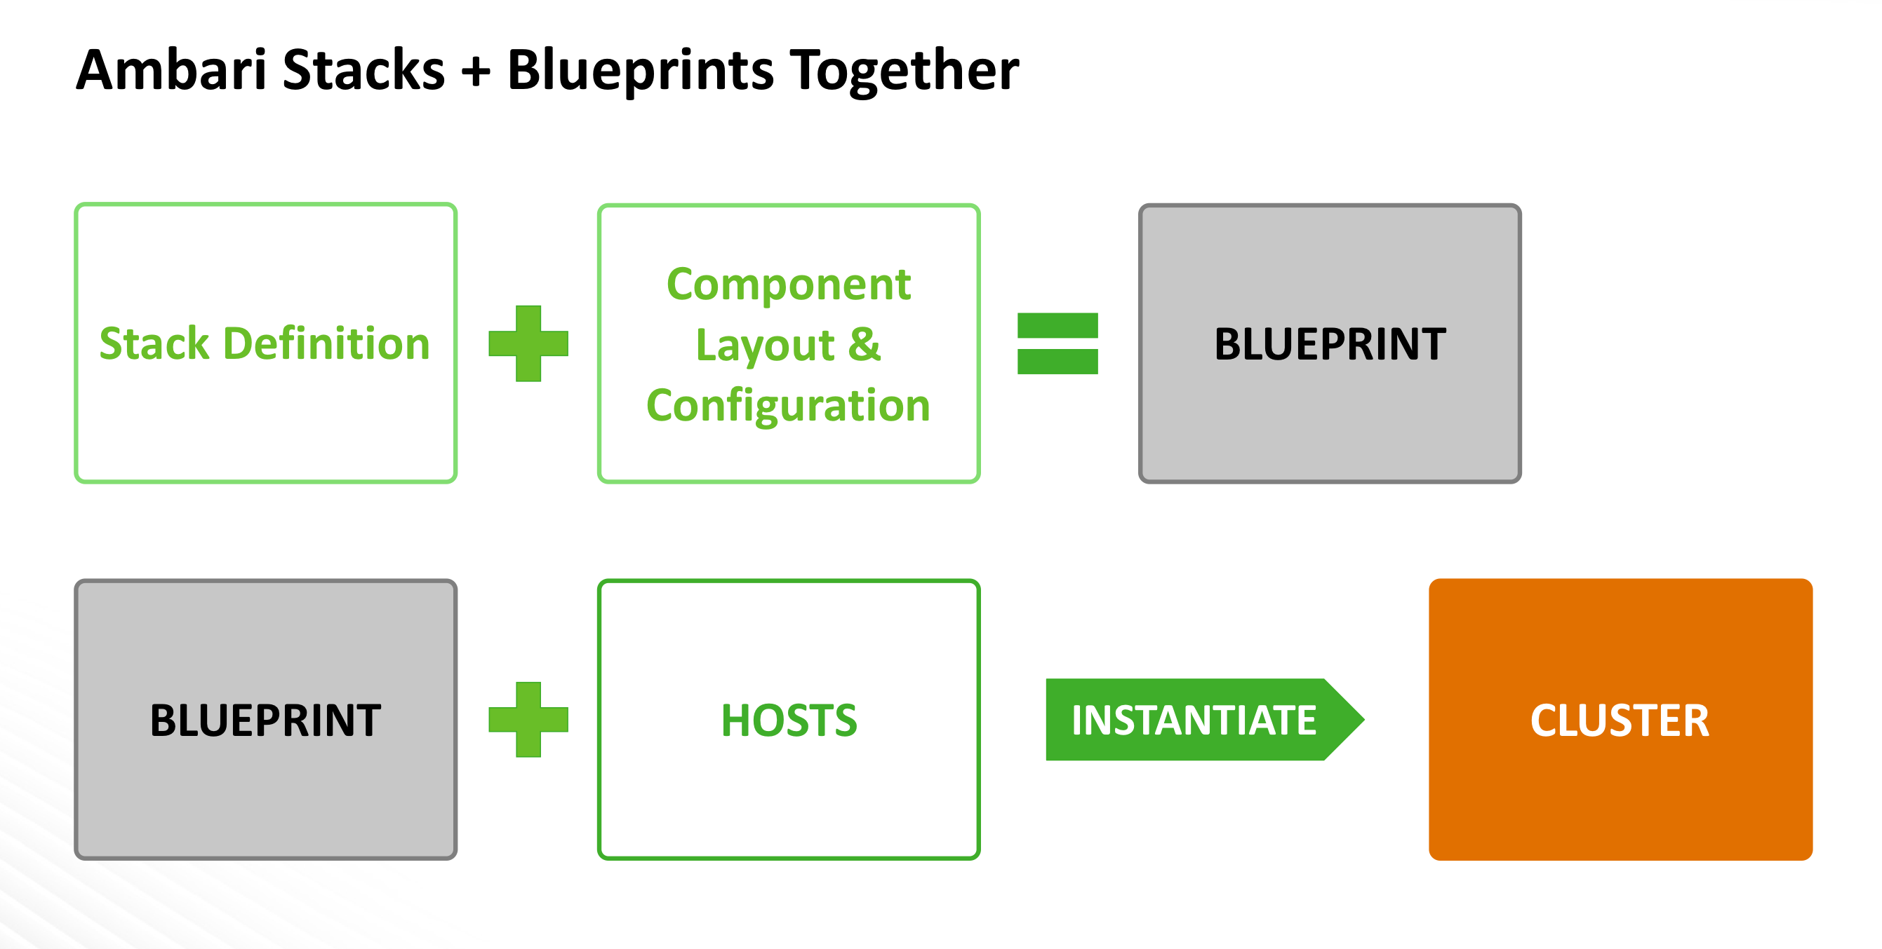
Ambari Blueprints
Two primary goals of Ambari Blueprints:
Ability to export a complete cluster description of a running cluster
Provide API-driven deployments based on self-contained cluster description
Notes:
Ok a couple of terms here but I am not going to bore you with that.
What happens is very simple. You issue one GET call to Ambari… it returns you the definition of current cluster in the form of a json.
You define another json with the host names etc and give these two in a POST calls to another Ambari which creates the complete cluster with out any more manual intervention.

Slide 27
Blueprints API
BLUEPRINT
1
POST /blueprints/my-blueprint
CLUSTER
CREATION
TEMPLATE
2
POST /clusters/MyCluster

Slide 28
Example: Single-Node Cluster
BLUEPRINT
Description
Single-node cluster
Use HDP 2.2 Stack
HDFS + YARN + MR2
Everything on c6401
{
"configurations" : [
{
”hdfs-site" : {
"dfs.namenode.name.dir" : ”/hadoop/nn"
}
}
],
"host_groups" : [
{
"name" : ”uber-host",
"components" : [
{ "name" : "NAMENODE” },
{ "name" : "SECONDARY_NAMENODE” },
{ "name" : "DATANODE” },
{ "name" : "HDFS_CLIENT” },
{ "name" : "RESOURCEMANAGER” },
{ "name" : "NODEMANAGER” },
{ "name" : "YARN_CLIENT” },
{ "name" : "HISTORYSERVER” },
{ "name" : "MAPREDUCE2_CLIENT” }
],
"cardinality" : "1"
}
],
"Blueprints" : {
"blueprint_name" : "single-node-hdfs-yarn",
"stack_name" : "HDP",
"stack_version" : "2.2"
}
}
CLUSTER CREATION TEMPLATE
{
"blueprint" : "single-node-hdfs-yarn",
"host_groups" :[
{
"name" : ”uber-host",
"hosts" : [
{
"fqdn" : "c6401.ambari.apache.org”
}
]
}
]
}

Slide 29
Security Setup

Slide 30
Authentication
Kerberos
LDAP/AD
PEM/Local Authentication
Custom

Slide 31
Kerberos
Hadoop Cluster
Kerberos is used to secure the Components in the cluster. Kerberos identities are managed via “keytabs” on the Component hosts.
Service Component A
Service Component B
Service Component C
Service Component D
keytab
keytab
keytab
keytab
Principals for the cluster are managed in the KDC.
Service Component X
Service Component X
Service Component X
Service Component X
KDC
keytab
keytab
keytab
keytab
Notes:
User provides KDC Admin Account credentials to Ambari
Ambari connects to KDC, creates principals (Service and Ambari) needed for cluster
Ambari generates keytabs for the principals
Ambari distributes keytabs to Ambari Server and cluster hosts
Ambari discards the KDC Admin Account credentials

Slide 32
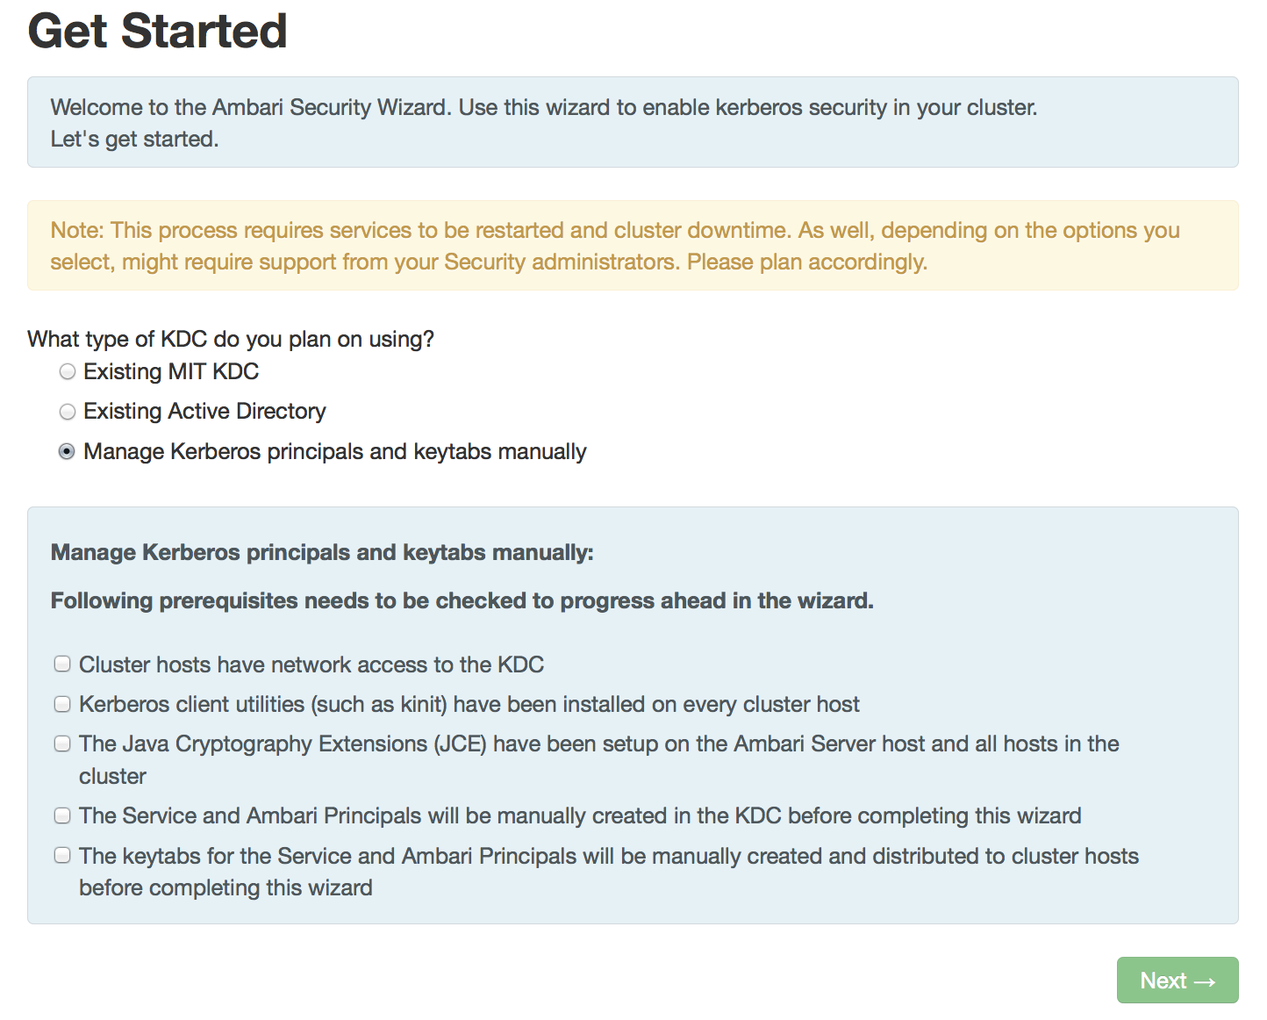
Automated Kerberos Security Setup
Wizard Driven Simplify the experience of enabling and managing Kerberos security
Automated and Manual Options Critical for today’s enterprise
Works with Existing Kerberos Infrastructure Such as Active Directory and MIT KDC

Slide 33
Role-Based Access Control (RBAC)

Slide 34
Role-Based Access Control
Use “roles” for more granular division of control for cluster operations
Old Permission | New Role | Notable Permissions
Operator | Cluster Administrator | Full operational control, including upgrades. Ambari Admins are implicitly granted this Role.
 | Cluster Operator | Adding and removing hosts.
 | Service Administrator | Manage configurations, move components.
 | Service Operator | Service stop and start and service-specific operations such as HDFS Rebalance.
Read-Only | Cluster User | View cluster service and host information.
Note: Users flagged as “Ambari Admins” are implicitly granted Cluster Administrator permission.

Slide 35
Managing Cluster Roles
Assign roles to users or groups
Manage roles in Block or List View layouts

Slide 36
Managing Cluster Roles
View users or groups
Change current role assignment

Slide 37
Automated Cluster Upgrade
Notes:
Why to upgrade?

Slide 38
Automated Upgrade: Rolling or Express Choice
Check Prerequisites
Prepare
Register + Install
Perform Upgrade
Finalize
Review the prerequisites to confirm your cluster configuration is ready for upgrade
Perform the preparation steps, which include making backups of critical cluster metadata.
Register the software repository and install the target version on the cluster.
Perform the upgrade. The steps depend on upgrade method: Rolling or Express.
Finalize the upgrade, making the target version the current version.
Notes:
Steps of overall upgrade process
Backup of critical cluster metadata
Change the symlinks

Slide 39
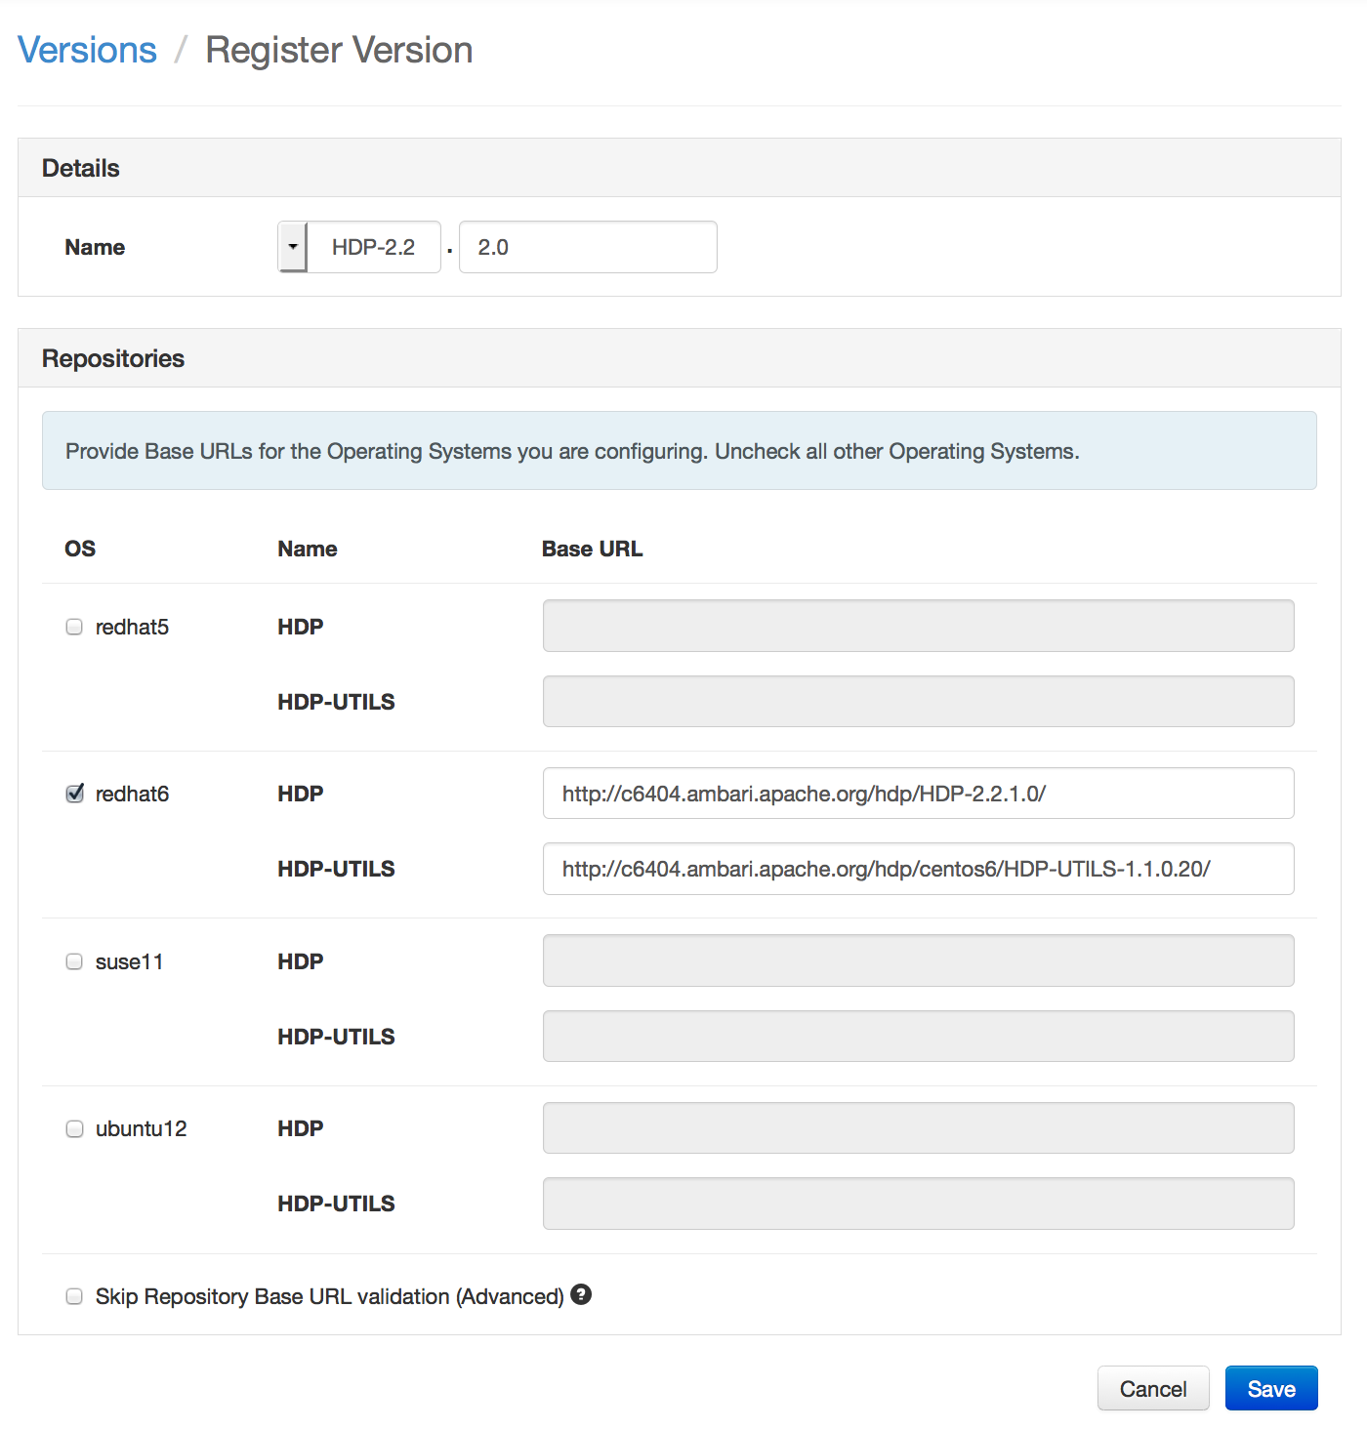
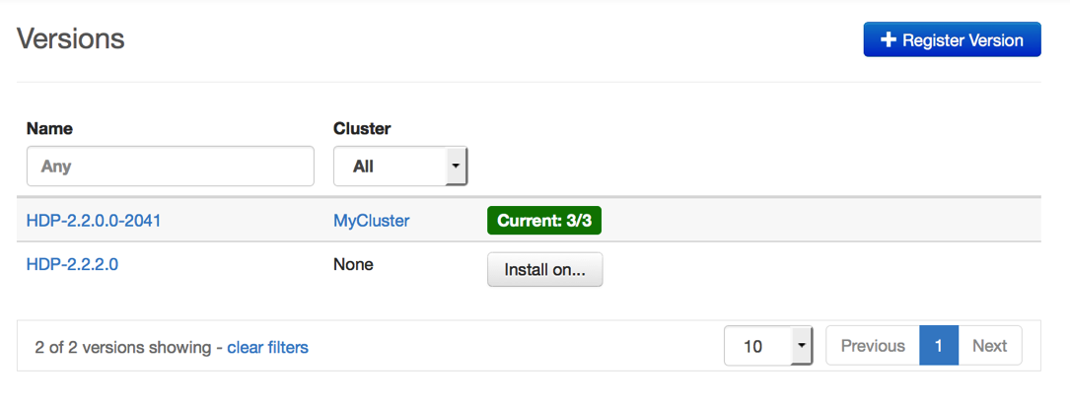


Register New Version
Register
Install
Perform
Upgrade
Finalize
Register new version with Ambari
Provide the Repository Base URLs for new version

Slide 40
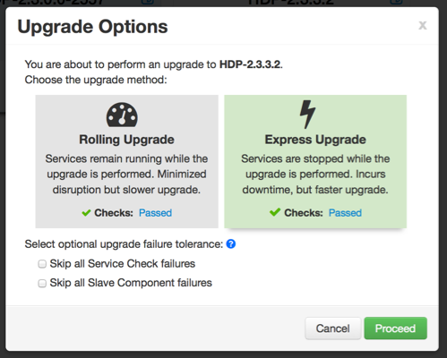
Upgrade Choice: Rolling or Express
Register
Install
Perform
Upgrade
Finalize
Notes:
Key Difference is there is a downtime in Express Upgrade as all the services are down once.
Rolling Upgrade: Orchestrates the cluster upgrade in an order that is meant to preserve cluster operation and minimize service impact. The tradeoff is more stringent prerequisites and a longer upgrade time.
Express Upgrade: Orchestrates the cluster upgrade in an order that will incur cluster downtime. This method has less stringent prerequisites but completes in a faster upgrade time.

Slide 41
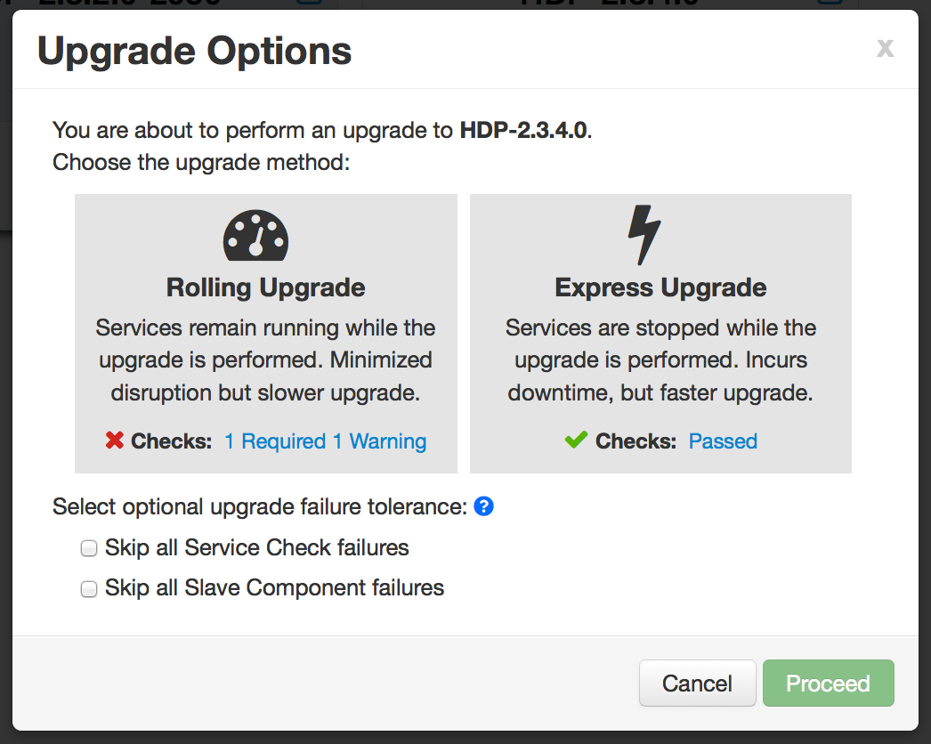
Upgrade Choice: Rolling or Express
Register
Install
Perform
Upgrade
Finalize
New options to handle failures
Notes:
Skip all Service Check failures: Ambari will automatically skip any Service Check failures and complete the task without requiring user intervention to continue. After all the Service Checks have run in a task, you will be presented with summary of the failures and an option to continue the upgrade or pause.
Skip all Slave Component failures: Ambari will automatically skip any Slave Component failures and complete the task of upgrading Slave components without requiring user intervention to continue. After all Slave Components have been upgraded, you will be presented with a summary of the failures and an option to continue the upgrade or pause.

Slide 42
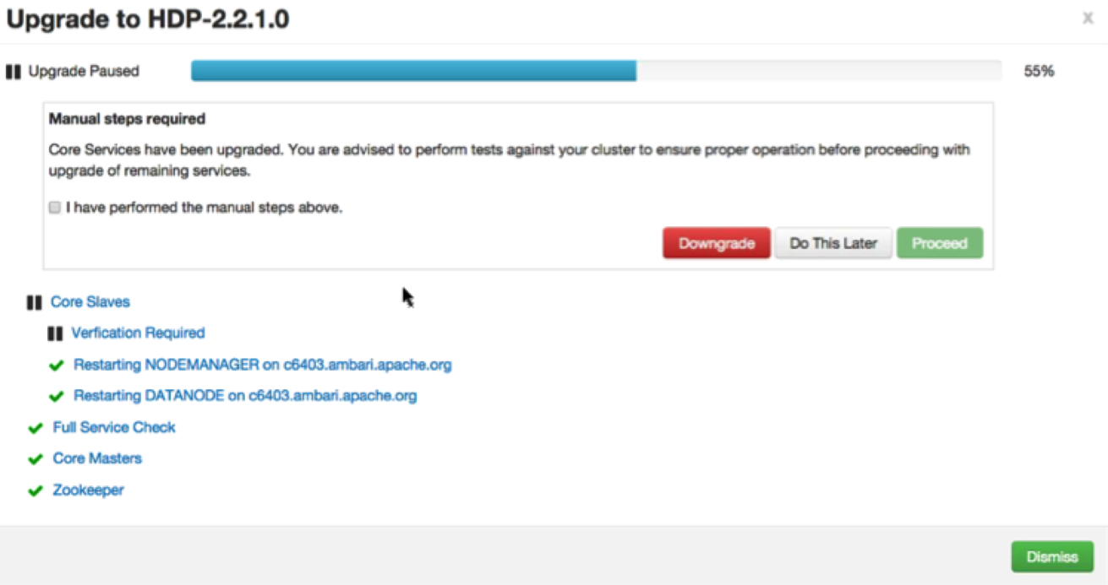
Wizard Driven Experience
Register
Install
Perform
Upgrade
Finalize
With verification and validation

Slide 43
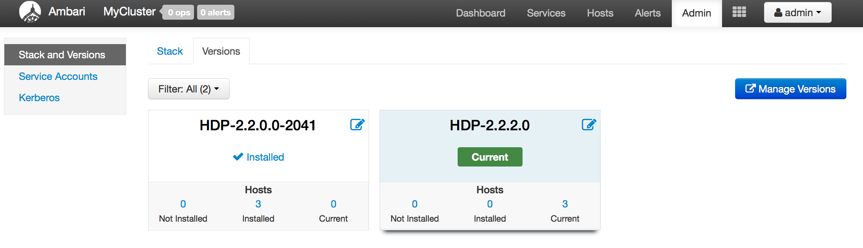
Rolling Upgrade – Success!
Register
Install
Perform
Upgrade
Finalize

Slide 44
Ambari Extensibility

Slide 45
Anatomy of Ambari Extension Points
Ambari
Web
Ambari
Server
Ambari
Agent
Ambari
Agent
Ambari
Agent
Stacks
js
java
Stacks
python
Stacks
Ambari Views
Ambari Stacks
Notes:
Technical anatomy of Ambari
Stacks: To add new Services beyond Stack, To customize a Stack for customer specific environments
Views: To extend and customize the Ambari Web UI, Add new capabilities, customize existing capabilities

Slide 46
Ambari Stacks

Slide 47

Ambari Stacks
Defines a consistent Stack lifecycle interface that can be extended
Encapsulates Stack Versions, Services, Components, Dependencies, Cardinality, Configurations, Commands
Dynamically add Stack + Service definitions
AMBARI
{rest}
HDFS
YARN
MR2
Stacks
Hive
HBase
Oozie
<ambari-web>
Falcon
Pig
Storm
Notes:
Stack: A set of Services, where to obtain the software packages and how to manage the lifecycle. (HDP 2.5, HDP 2.6)
Service: Defines the Components that make-up the Service. (HDFS, YARN, HIVE, SPARK)
Component: The building-blocks of a Service, that adhere to a certain lifecycle. (NAMENODE, DATANODE)

Slide 48
Stack Mechanics
Stacks define Services + Repos
What is in the Stack, and where to get the bits
Each Service has a definition
What Components are part of the Service
Each Service has defined lifecycle commands
start, stop, status, install, configure
Lifecycle is controlled via command scripts
Ability to define “custom” commands
AMBARI
SERVER
Repos
AMBARI
AGENT/S
Stack
AMBARI
AGENT/S
AMBARI
AGENT/S
Service Definitions
Command Scripts
xml
python
Notes:
Overrides any Service definitions, commands and configurations
Adds new Services specific to this Stack
Defines a set of Service definitions
Default service configurations and command scripts

Slide 49
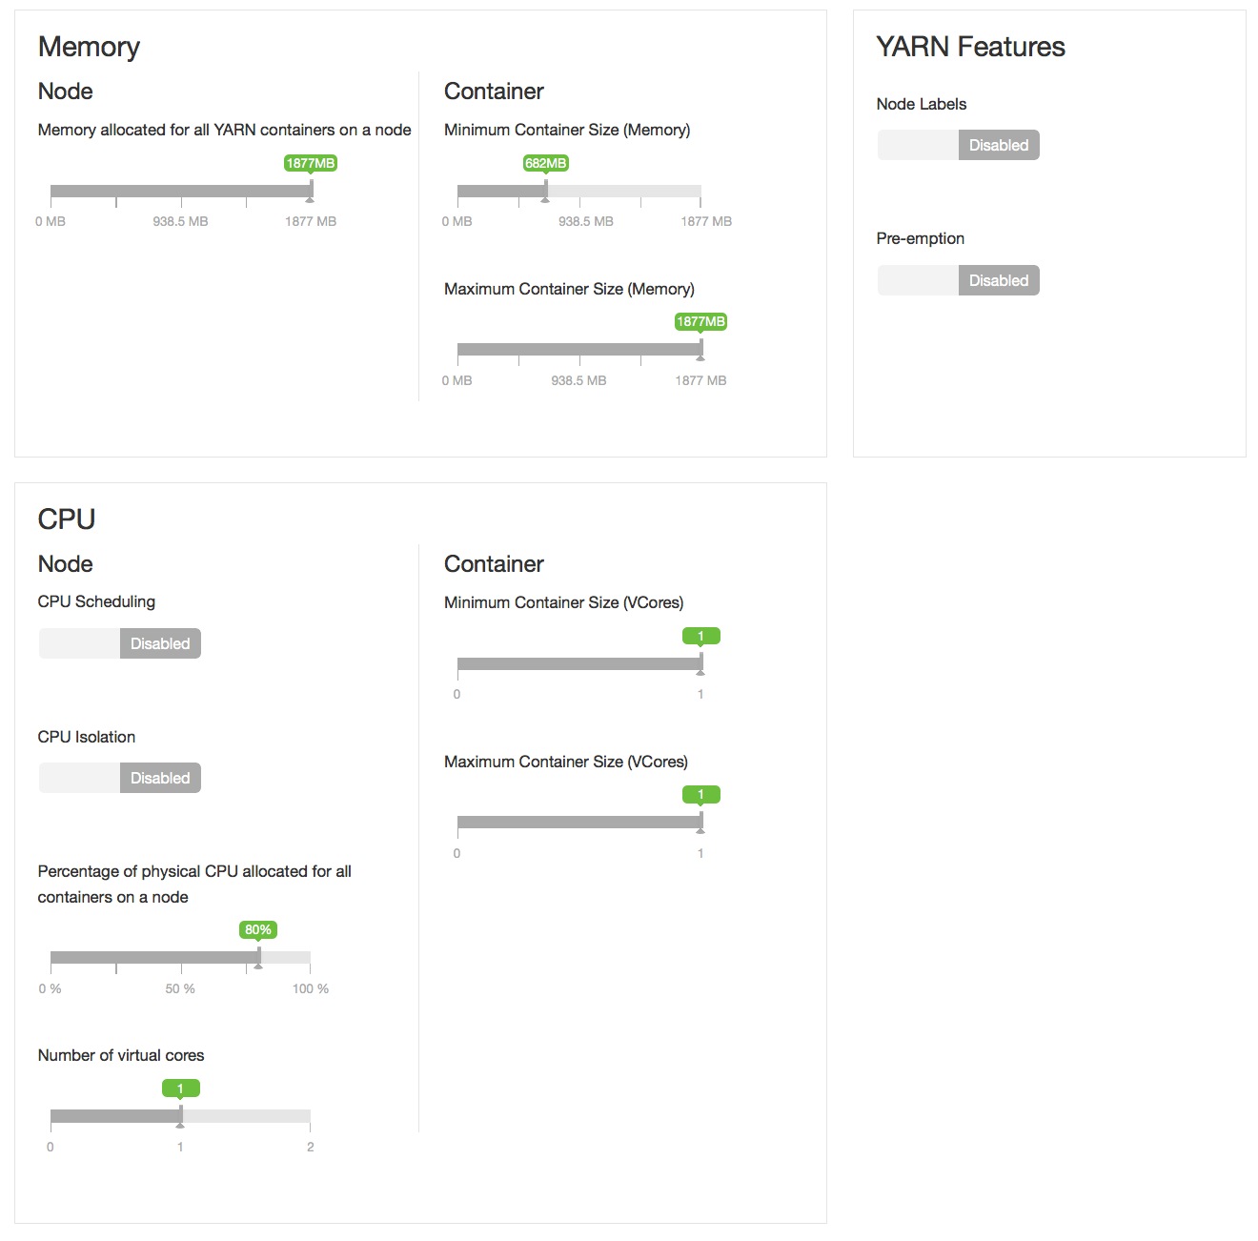
Smart Configurations using theme.json
Notes:
Take the guesswork out of cluster configuration
Driven by Stack definition
Intuitive layout and grouping of configurations
Smart UI controls to make it easier to set values
Recommendations and cross-service dependency checks

Slide 50
Ambari Views

Slide 51
Views Framework vs. Views
Views
Built by Hortonworks, Community, Partners
Views Framework
Core to Ambari
Notes:
Developers can extend the Ambari Web interface: Views expose custom UI features for Hadoop Services
Ambari Admin can entitle Views to Ambari Web users: Entitlements framework for controlling access to Views

Slide 52
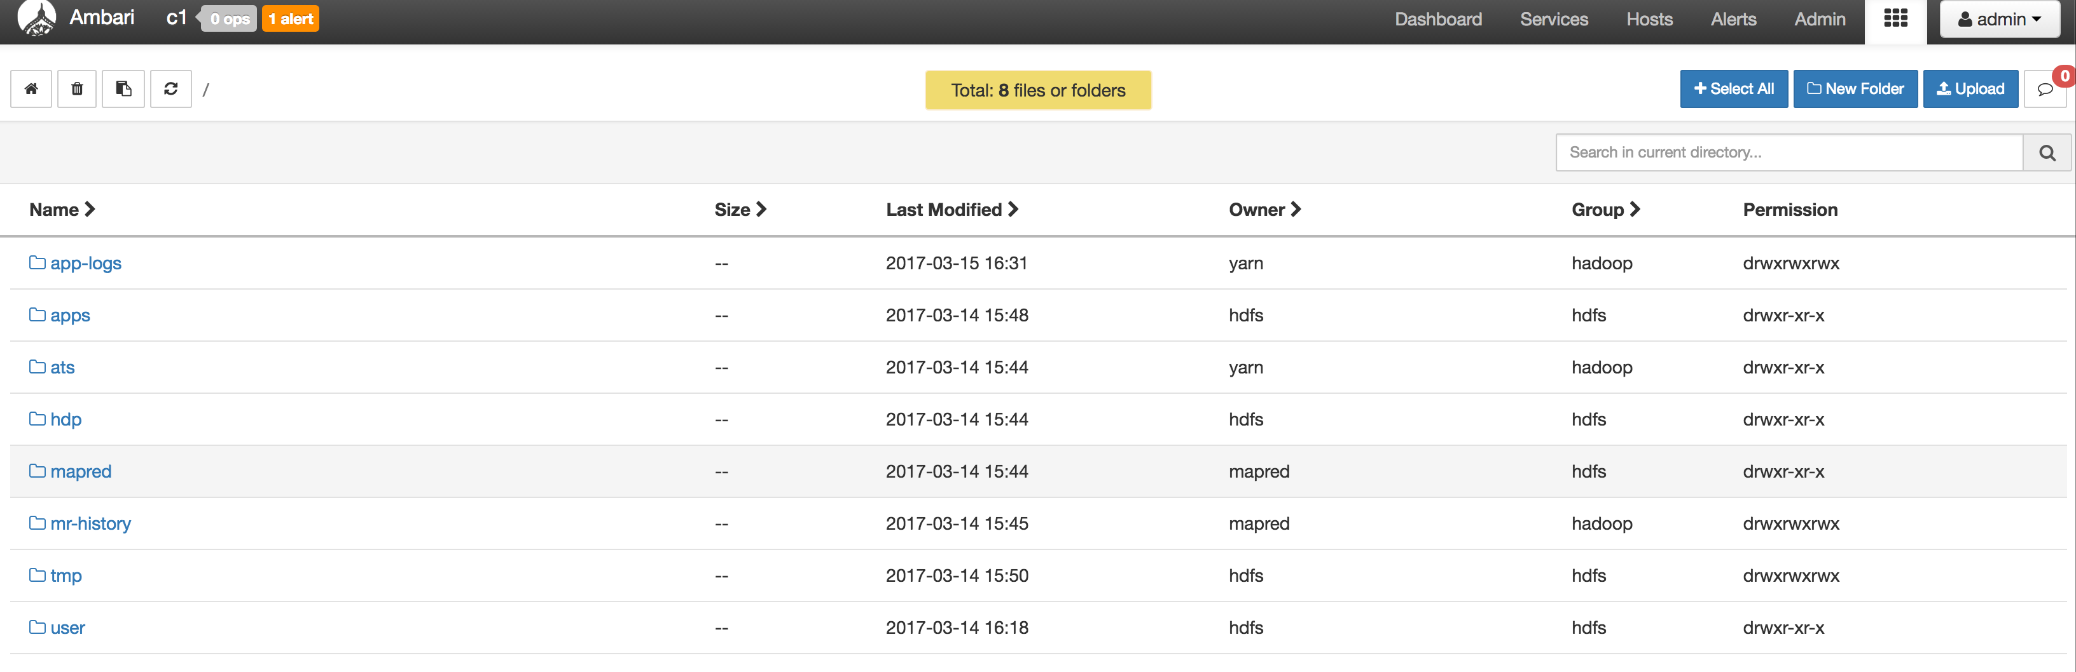
Files View
Notes:
UI version of Hadoop terminal
All the terminal operations like create directory, copy file, remove file, chmod etc are possible through this UI.

Slide 53
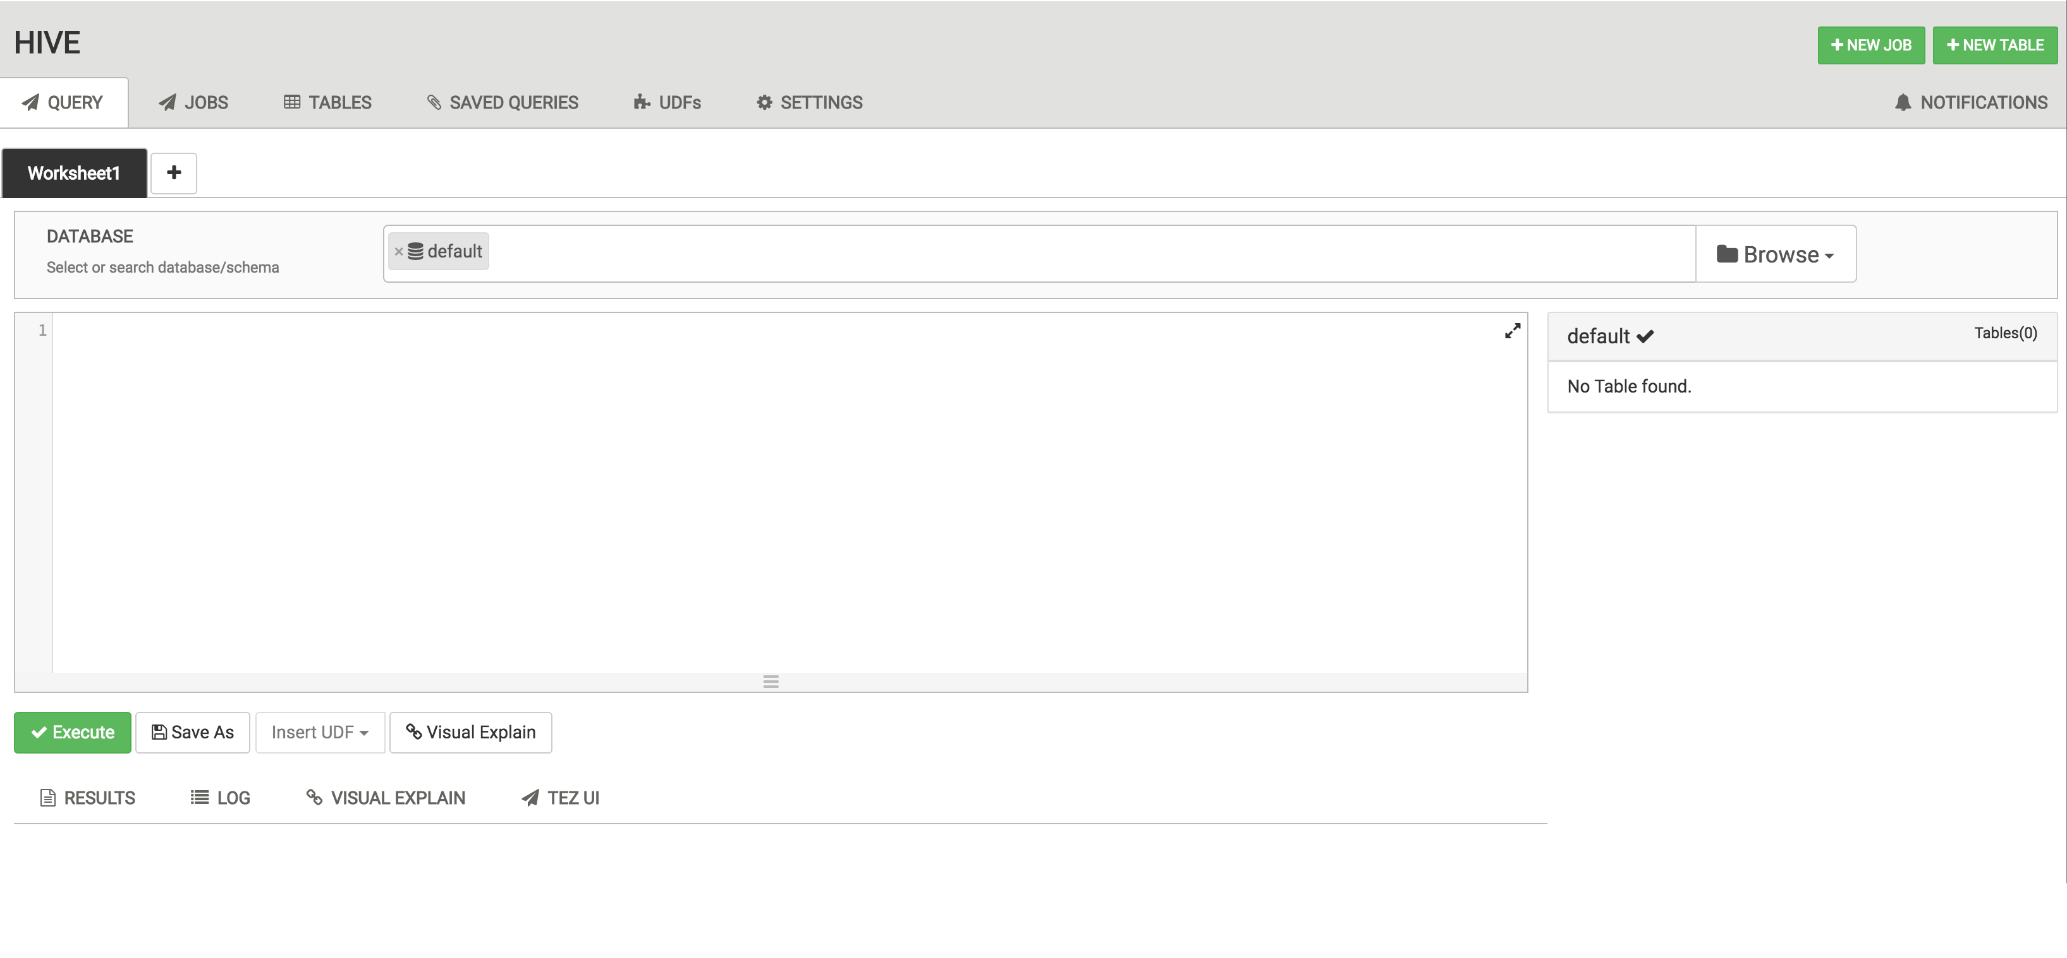
Hive 2.0 View
Notes:
UI project for Hive Query Engine
Can execute queries, multiple queries through UI. Can visualize the a complex query

Slide 54
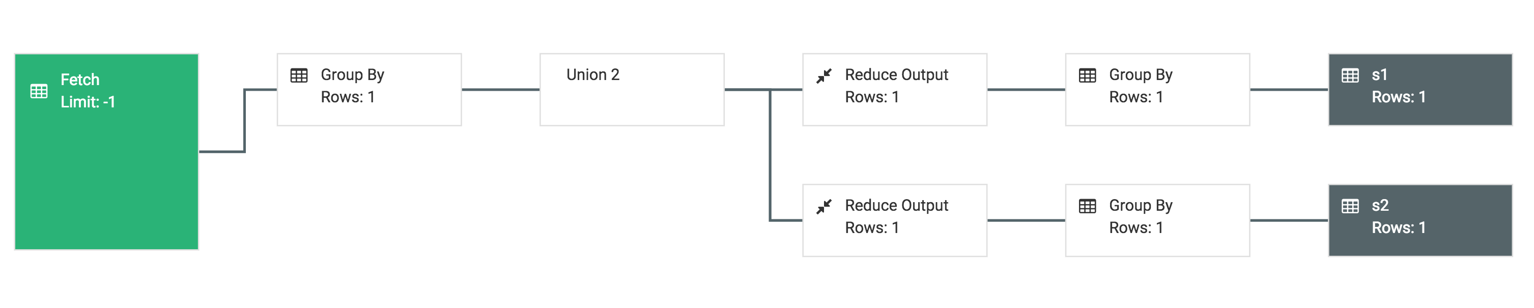
Hive 2.0 : Visual Explain Feature
Notes:
Can visualize the a complex query

Slide 55
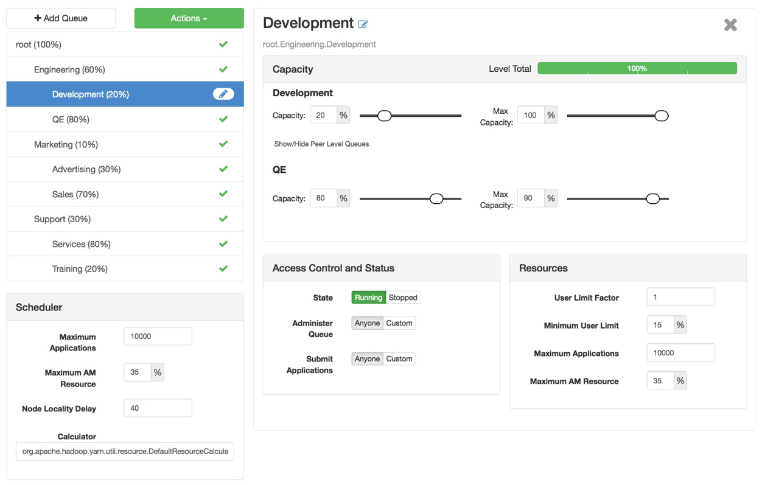
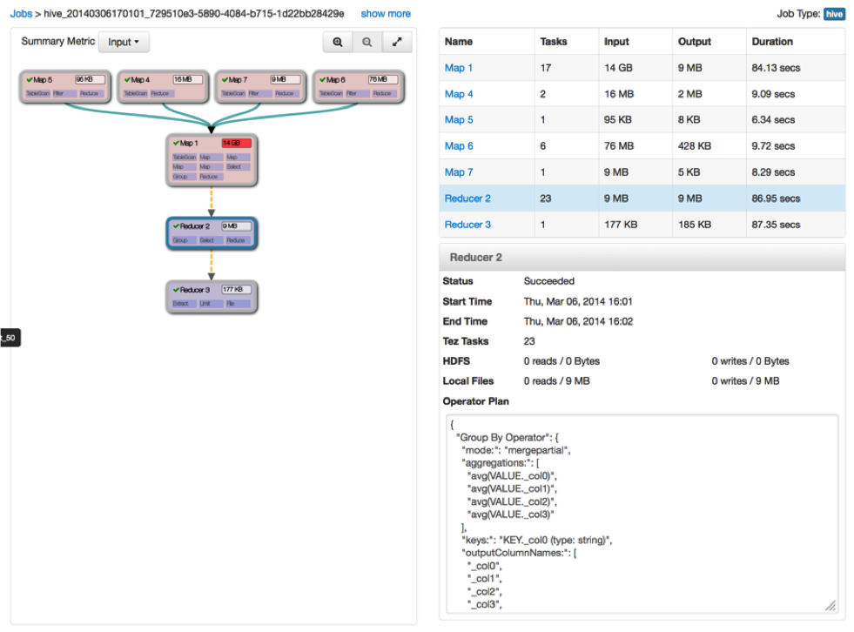
Some More Views
Capacity Scheduler
“Queue Manager” View
Tez
“Jobs” View

Slide 56
View Components
Serve client-side assets (such as HTML + JavaScript)
Expose server-side resources (such as REST endpoints)
AMBARI WEB
AMBARI SERVER
VIEW
Client-side assets
(.js, html)
VIEW
Server-side resources
(java)
Hadoop and other systems
{rest}

Slide 57
View Delivery
Develop the View (just like you would for a Web App)
Package as a View (basically a JAR)
Deploy the View into Ambari
Ambari Admins create + configuration view instance(s) and give access to users + groups
Can Deploy multiple versions and create multiple instances of a view
Develop
Package
Deploy
Create Instance(s)

Slide 58


Choice of Deployment Model
For Hadoop Operators:
Deploy Views in an Ambari Server that is managing a Hadoop cluster
For Data Workers:
Run Views in a “standalone” Ambari Server
Operators manage the cluster, may have Views deployed
Ambari
Server
HADOOP
Store & Process
Data Workers use the cluster and use a “standalone” Ambari Server for Views
Ambari
Server
Notes:
It can have multiple ambari views server for improved performance behind the load balancer.
Helps you in the scale.

Slide 59
Learn More About Apache Ambari
Resource | Location
Apache Ambari Project Page | http://ambari.apache.org
Ambari Project Wiki | https://cwiki.apache.org/confluence/display/AMBARI
Ambari Project JIRA | https://issues.apache.org/jira/browse/AMBARI
Stacks | https://cwiki.apache.org/confluence/pages/viewpage.action?pageId=38571133
Blueprints | https://cwiki.apache.org/confluence/display/AMBARI/Blueprints
Views | https://cwiki.apache.org/confluence/display/AMBARI/Views

Slide 60
Thank You

